Slide 1
C++ is Fun – Part Four at Turbine/Warner Bros.!
Russell Hanson

Slide 2
Brief Overview
We will do some lab examples using simple classes with private data and access functions like get() and set().
Opening and reading Excel files and using/installing external libraries/API’s
Introduction to typedef, struct, and enum
Some first gameplay classes

Slide 3
Typdef, struct, and enum
3 Ways to declare struct student:
1.
struct student {
char id_num[5];
char name[10];
char gender;
int age;
} studno_1, studno_2;
2.
struct { // no tag
char id_num[5];
char name[10];
char gender;
int age;
} studno_1, studno_2;
3. struct student{
char id_num[5];
char name[10];
char gender;
int age;
};
Here, struct is a keyword that tells the compiler that a structure template is being declared and student is a tag that identifies its data structure. Tag is not a variable; it is a label for the structure’s template. Note that there is a semicolon after the closing curly brace
In the program declare as:
struct student studno_1, studno_2;
In (2) there is no structure tag, this means we cannot declare structure variables of this type elsewhere in the program instead we have to use the structure variables studno_1 and studno_2 directly.

Slide 4
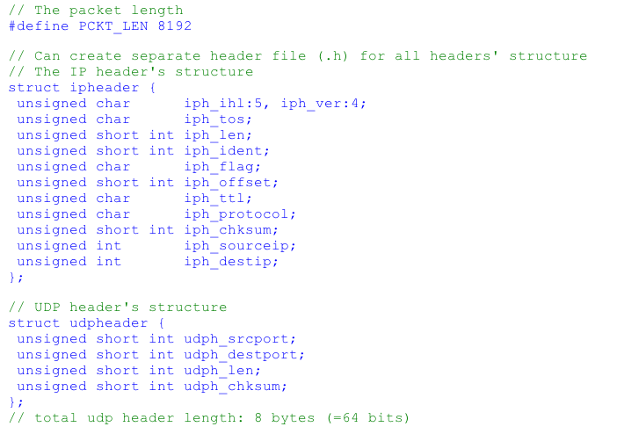
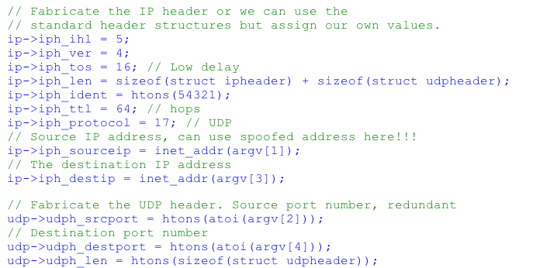
Initialize struct
Use the (->) structure pointer operator
// Our own headers' structures
struct ipheader *ip = (struct ipheader *) buffer;
struct udpheader *udp = (struct udpheader *) (buffer + sizeof(struct ipheader));

Slide 5
In class example! Typing is good for character(s)
//accessing structure element
#include <iostream.h>
#include <stdlib.h>
struct Card
{
char *face; //pointer to char type
char *suit; //pointer to char type
};
int main()
{
//declare the struct type variables
struct Card p;
struct Card *SPtr;
p.face = "Ace";
p.suit = "Spades";
SPtr = &p;
cout<<"Accessing structure element:\n";
cout<<"\n\'SPtr->suit\' = "<<SPtr->suit<<endl;
cout<<"\'SPtr->face\' = "<<SPtr->face<<endl;
// cout<<"\n\'SPtr->suit\' = "<<p->suit<<endl; // ERROR
// cout<<"\'SPtr->face\' = "<<p->face<<endl; // ERROR
// structtest.cpp:23: error: base operand of ‘->’ has non-pointer type ‘Card’
// structtest.cpp:24: error: base operand of ‘->’ has non-pointer type ‘Card’
}
// Running the program:
// ./structtest
// Accessing structure element:
// 'SPtr->suit' = Spades
// 'SPtr->face' = Ace

Slide 6
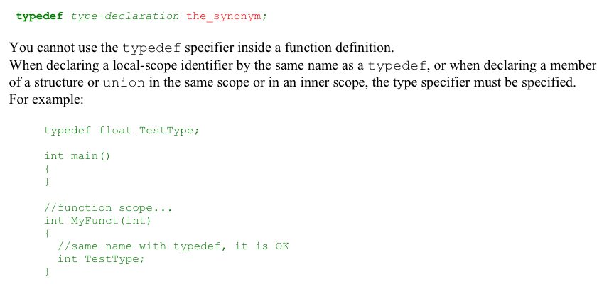

Slide 7
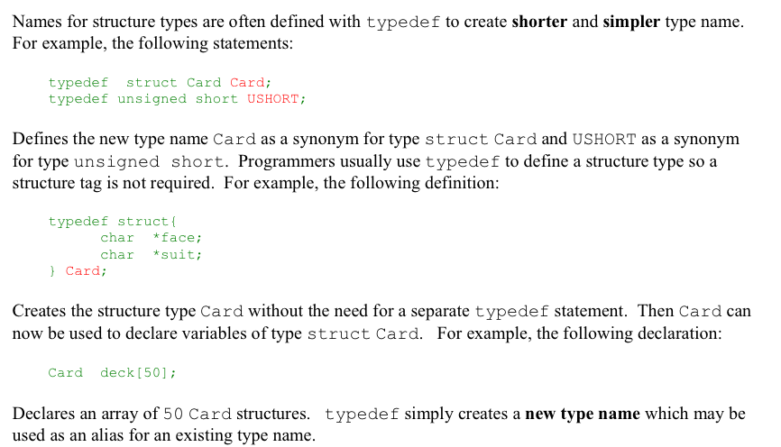

Slide 8
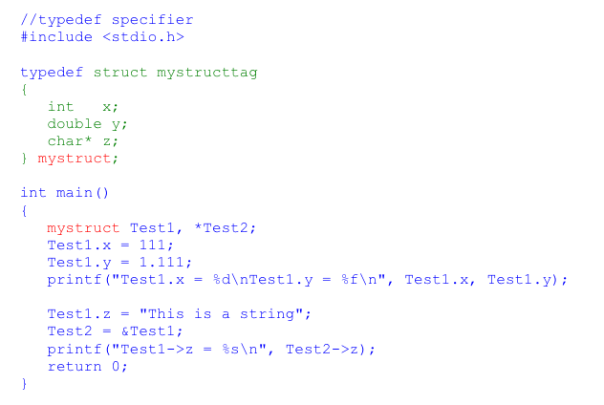
$ ./structexample
Test1.x = 111
Test1.y = 1.111000
Test1->z = This is a string

Slide 9
In class typedef example! Typing is good for character(s)
//accessing structure element
#include <iostream.h>
#include <stdlib.h>
typedef struct Card
{
char *face; //pointer to char type
char *suit; //pointer to char type
};
int main()
{
//declare the struct type variables
Card p;
Card *SPtr;
p.face = "Ace";
p.suit = "Spades";
SPtr = &p;
cout<<"Accessing structure element:\n";
cout<<"\n\'SPtr->suit\' = "<<SPtr->suit<<endl;
cout<<"\'SPtr->face\' = "<<SPtr->face<<endl;
// cout<<"\n\'SPtr->suit\' = "<<p->suit<<endl; // ERROR
// cout<<"\'SPtr->face\' = "<<p->face<<endl; // ERROR
// structtest.cpp:23: error: base operand of ‘->’ has non-pointer type ‘Card’
// structtest.cpp:24: error: base operand of ‘->’ has non-pointer type ‘Card’
}
// Running the program:
// ./structtest
// Accessing structure element:
// 'SPtr->suit' = Spades
// 'SPtr->face' = Ace

Slide 10
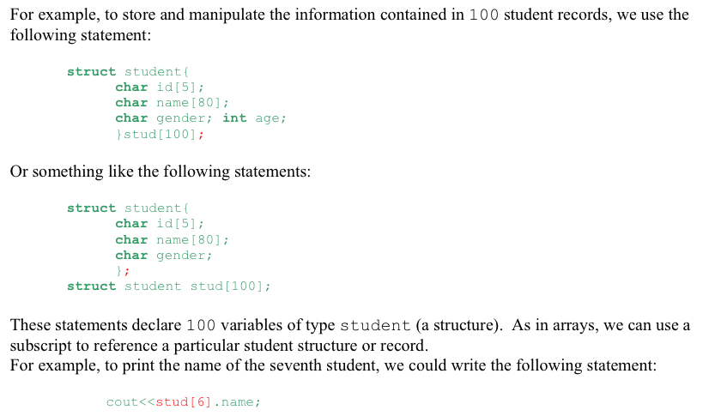
Arrays of Structures

Slide 11
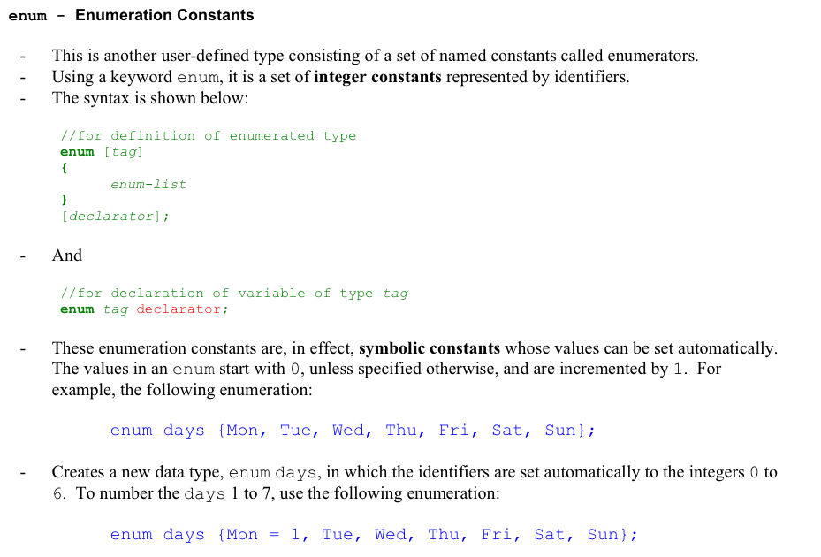

Slide 12
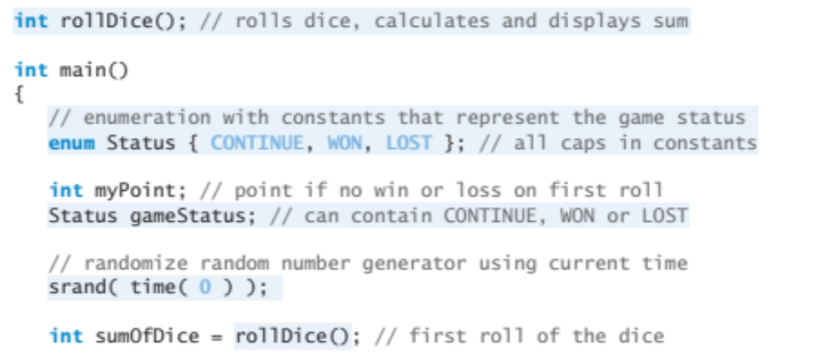
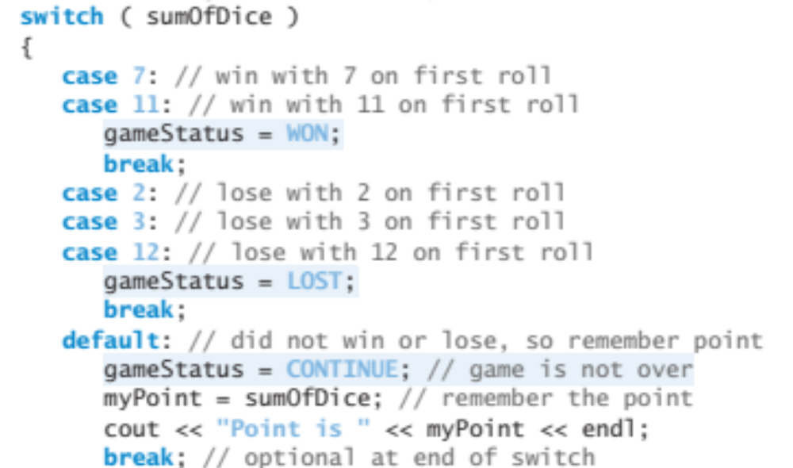
(…)

Slide 13
How to download an API off the internet and use it! ☺
API’s or “Application Programming Interfaces” are tools programmers use to add functionality to their programs and essentially these contain 1) header files (.h) and 2) library files (.dll or .lib)
Examples include: physics engines, GUI libraries, game engines, Excel file reading engines, etc. … you name it.

Slide 14
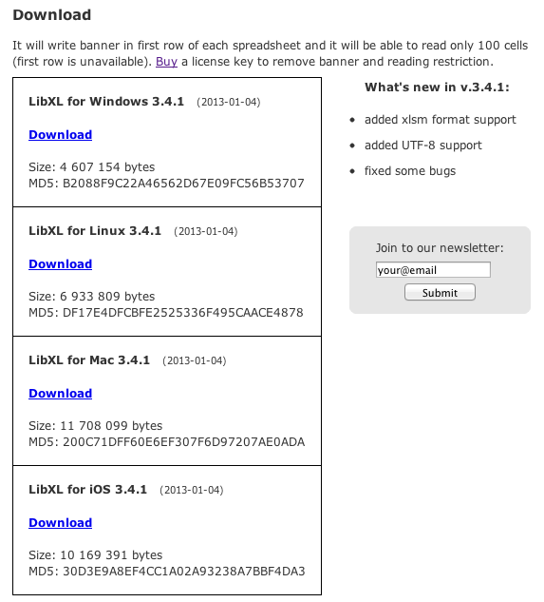
Using the Excel Library “libxl”
http://www.libxl.com/download.html

Slide 15
Using the Excel Library “libxl”
LibXL is a library for direct reading and writing Excel files.
Package contents:
bin 32-bit dynamic library
bin64 64-bit dynamic library
doc C++ documentation
examples C, C++, C#, Delphi and Fortran examples (MinGW, Visual Studio, Qt, Code::Blocks)
include_c headers for C
include_cpp headers for C++
lib 32-bit import library for Microsoft Visual C++
lib64 64-bit import library for Microsoft Visual C++
net .NET wrapper (assembly)
changelog.txt change log
libxl.url link to home page
license.txt end-user license agreement
readme.txt this file
Using library:
1. Microsoft Visual C++
- add include directory in your project, for example: c:\libxl\include_cpp
Project -> Properties -> C/C++ -> General -> Additional Include Directories
- add library directory in your project, for example: c:\libxl\lib
Project -> Properties -> Linker -> General -> Additional Library Directories
- add libxl.lib in project dependencies:
Project -> Properties -> Linker -> Input -> Additional Dependencies
- copy bin\libxl.dll to directory of your project

Slide 16
Using the Excel Library “libxl”
Using library:
1. Microsoft Visual C++
- add include directory in your project, for example: c:\libxl\include_cpp
Project -> Properties -> C/C++ -> General -> Additional Include Directories
- add library directory in your project, for example: c:\libxl\lib
Project -> Properties -> Linker -> General -> Additional Library Directories
- add libxl.lib in project dependencies:
Project -> Properties -> Linker -> Input -> Additional Dependencies
- copy bin\libxl.dll to directory of your project

Slide 17
Using the Excel Library “libxl”
#include <iostream>
#include <conio.h>
#include "libxl.h"
using namespace libxl;
int main()
{
Book* book = xlCreateBook();
if(book)
if(book->load(L"..\\generate\\example.xls"))
{
Sheet* sheet = book->getSheet(0);
if(sheet)
{
const wchar_t* s = sheet->readStr(2, 1);
if(s) std::wcout << s << std::endl << std::endl;
std::cout << sheet->readNum(4, 1) << std::endl;
std::cout << sheet->readNum(5, 1) << std::endl;
const wchar_t* f = sheet->readFormula(6, 1);
if(f) std::wcout << f << std::endl << std::endl;
int year, month, day;
book->dateUnpack(sheet->readNum(8, 1), &year, &month, &day);
std::cout << year << "-" << month << "-" << day << std::endl;
}
}
else
{
std::cout << "At first run generate !" << std::endl;
}
book->release();
}
std::cout << "\nPress any key to exit...";
_getch();
return 0;
}

Slide 18
Using the Excel Library “libxl”
const wchar_t* f = sheet->readFormula(6, 1);
if(f) std::wcout << f << std::endl << std::endl;
int year, month, day;
book->dateUnpack(sheet->readNum(8, 1), &year, &month, &day);
std::cout << year << "-" << month << "-" << day << std::endl;
}
}
else
{
std::cout << "At first run generate !" << std::endl;
}
book->release();
}
std::cout << "\nPress any key to exit...";
_getch();
return 0;
}

Slide 19
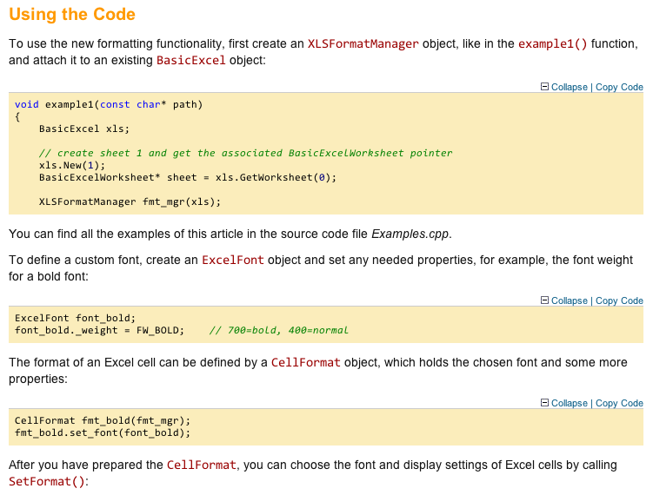
LibXL is pay software, ExcelFormat is another FREE option
It will write banner in first row of each spreadsheet and it will be able to read only 100 cells (first row is unavailable). Buy a license key to remove banner and reading restriction. –your friends at LibXL
http://www.codeproject.com/Articles/42504/ExcelFormat-Library

Slide 20
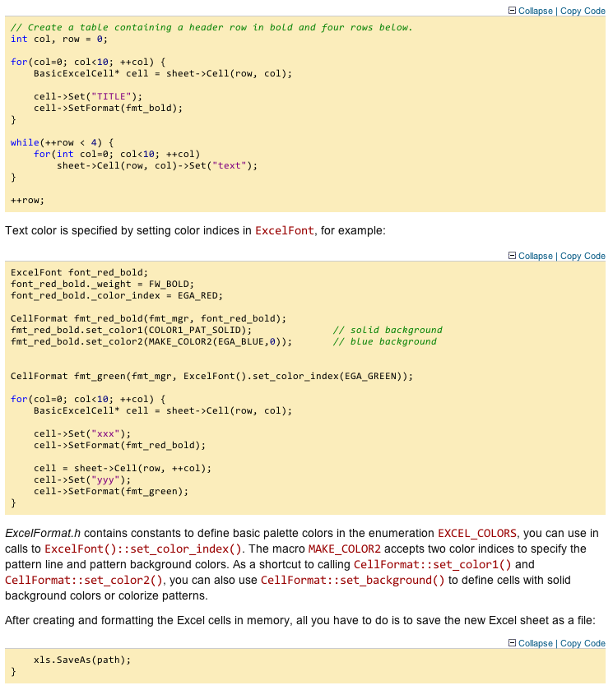

Slide 21
What these Excel interfaces are actually doing….
struct CODE
{
enum { FORMULA=0x0006, //Token array and the result of a formula cell.
YEOF=0x000A, //End of a record block with leading BOF record.
CALCCOUNT=0x000C, //Maximum number of times the forumlas should be iteratively calculated
CALCMODE=0x000D, //Calculate formulas manually, automatically, or automatically except for multiple table operations
PRECISION=0x000E, //Whether formulas use the real cell values for calculation or the values displayed on the screen.
REFMODE=0x000F, //Method used to show cell addresses in formulas.
DELTA=0x0010, //Maximum change of the result to exit an iteration.
ITERATION=0x0011, //Whether iterations are allowed while calculating recursive formulas.
PROTECT=0x0012, //Whether worksheet or a workbook is protected against modification.
PASSWORD=0x0013, //16-bit hash value, calculated from the worksheet or workbook protection password.
HEADER=0x0014, //Page header string for the current worksheet.
FOOTER=0x0015, //Page footer string for the current worksheet.
EXTERNSHEET=0x0017, //List with indexes to SUPBOOK records
NAME=0x0018, //Name and token array of an internal defined name.
…

Slide 22
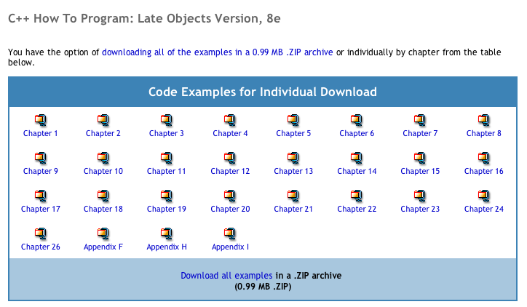
You can download the class example programs from here:
http://media.pearsoncmg.com/ph/esm/deitel/cpp_htp_8/code_examples/code_examples.html

Slide 23
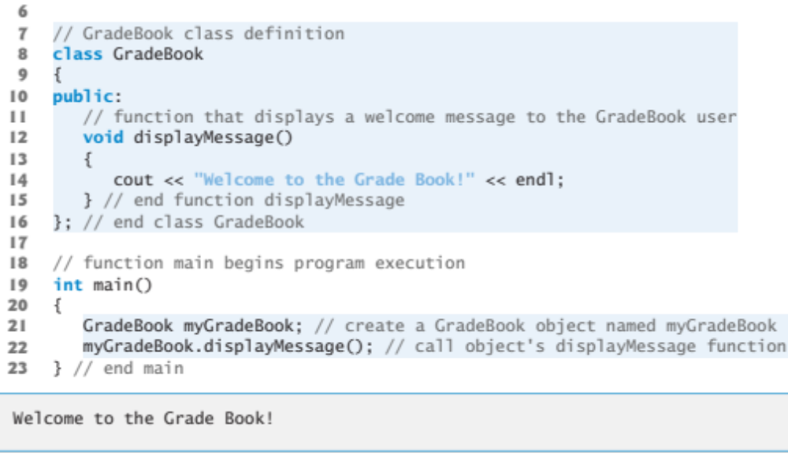
A simple class GradeBook

Slide 24
This is the copy-paste-able source code
Let’s compile & run the program!
// Define class GradeBook with a member function displayMessage;
// Create a GradeBook object and call its displayMessage function.
#include <iostream>
using namespace std;
// GradeBook class definition
class GradeBook
{
public:
// function that displays a welcome message to the GradeBook user
void displayMessage()
{
cout << "Welcome to the Grade Book!" << endl;
} // end function displayMessage
}; // end class GradeBook
// function main begins program execution
int main()
{
GradeBook myGradeBook; // create a GradeBook object named myGradeBook
myGradeBook.displayMessage(); // call object's displayMessage function
} // end main

Slide 25
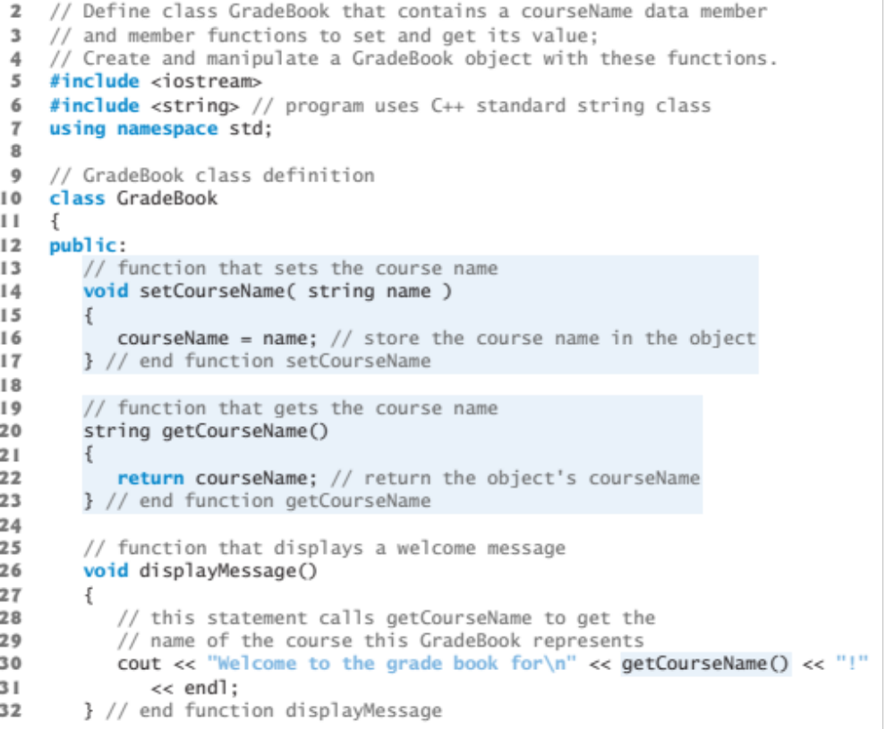
Add set() and get() functions to the class

Slide 26
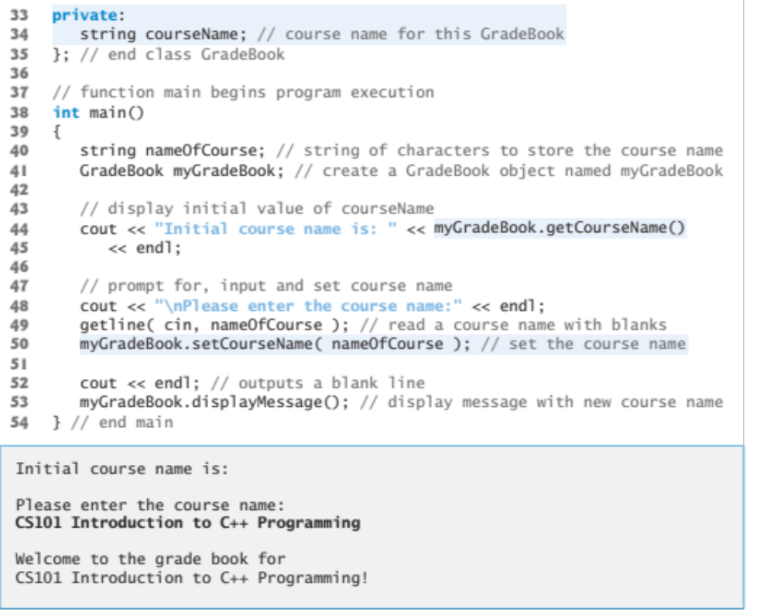

Slide 27
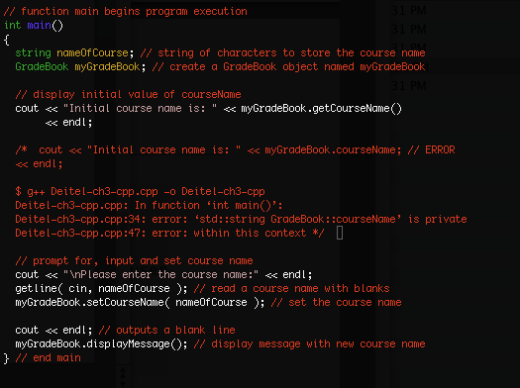
Dear class, let’s try, and fail, to access a private member of a class (without a get() function)

Slide 28
This is the copy-paste-able source code for the class program with get() and set() parameters
// Define class GradeBook that contains a courseName data member
// and member functions to set and get its value;
// Create and manipulate a GradeBook object.
#include <iostream>
#include <string> // program uses C++ standard string class
using namespace std;
// GradeBook class definition
class GradeBook
{
public:
// function that sets the course name
void setCourseName( string name )
{
courseName = name; // store the course name in the object
} // end function setCourseName
// function that gets the course name
string getCourseName()
{
return courseName; // return the object's courseName
} // end function getCourseName
// function that displays a welcome message
void displayMessage()
{
// this statement calls getCourseName to get the
// name of the course this GradeBook represents
cout << "Welcome to the grade book for\n" << getCourseName() << "!"
<< endl;
} // end function displayMessage
private:
string courseName; // course name for this GradeBook
}; // end class GradeBook
// function main begins program execution
int main(){
string nameOfCourse; // string of characters to store the course name
GradeBook myGradeBook; // create a GradeBook object named myGradeBook
// display initial value of courseName
cout << "Initial course name is: " << myGradeBook.getCourseName()
<< endl;
// prompt for, input and set course name
cout << "\nPlease enter the course name:" << endl;
getline( cin, nameOfCourse ); // read a course name with blanks
myGradeBook.setCourseName( nameOfCourse ); // set the course name
cout << endl; // outputs a blank line
myGradeBook.displayMessage(); // display message with new course name
} // end main

Slide 29
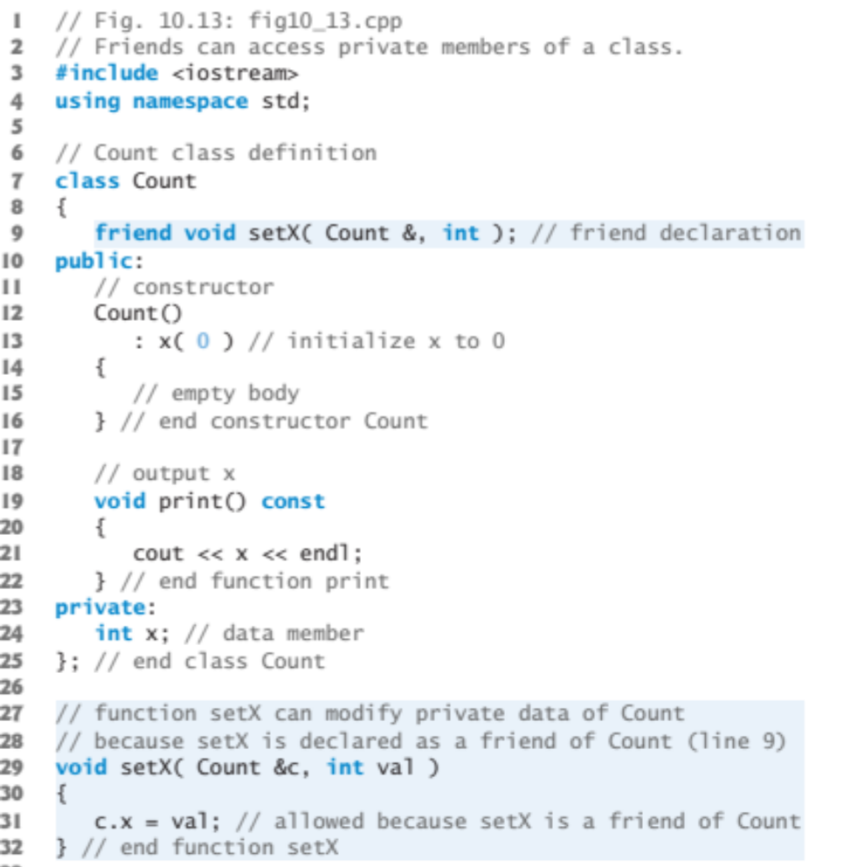
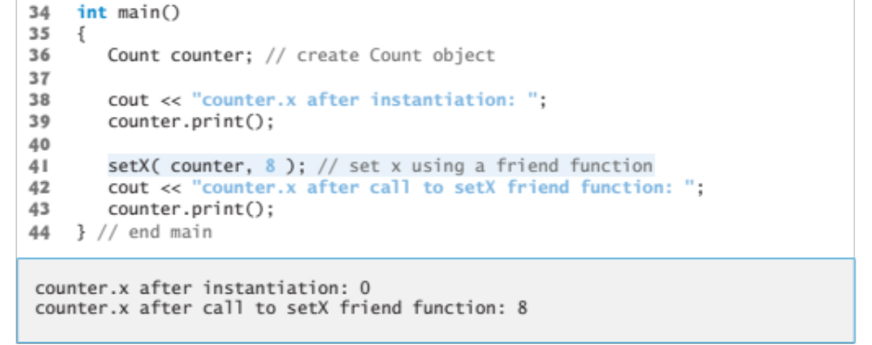
However, with a friend function we can access the private members

Slide 30
This is the copy-paste-able source code for using friends to access private parts
#include <iostream>
using namespace std;
// Count class definition
class Count
{
// friend void setX( Count &, int ); // friend declaration
void setX( Count &, int ); // friend declaration
public:
// constructor
Count()
: x( 0 ) // initialize x to 0
{
// empty body
} // end constructor Count
// output x
void print() const
{
cout << x << endl;
} // end function print
private:
int x; // data member
}; // end class Count
// function setX can modify private data of Count
// because setX is declared as a friend of Count (line 9)
void setX( Count &c, int val )
{
c.x = val; // allowed because setX is a friend of Count
} // end function setX
int main(){
Count counter; // create Count object
cout << "counter.x after instantiation: ";
counter.print();
setX( counter, 8 ); // set x using a friend function
cout << "counter.x after call to setX friend function: ";
counter.print();
} // end main

Slide 31
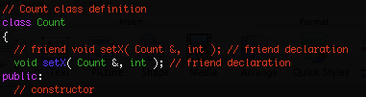
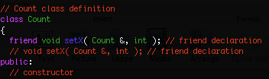
Without friend – compiler error
$ g++ friend.cpp -o friendcpp
friend.cpp: In function ‘void setX(Count&, int)’:
friend.cpp:25: error: ‘int Count::x’ is private
friend.cpp:32: error: within this context
With friend
$ g++ friend.cpp -o friendcpp
Russells-MacBook-Pro:TurbineWarnerBros russell$ ./friendcpp
counter.x after instantiation: 0
counter.x after call to setX friend function: 8

Slide 32
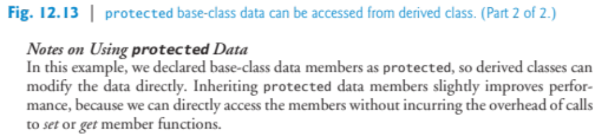
Protected base-class data can be accessed from derived classes

Slide 33
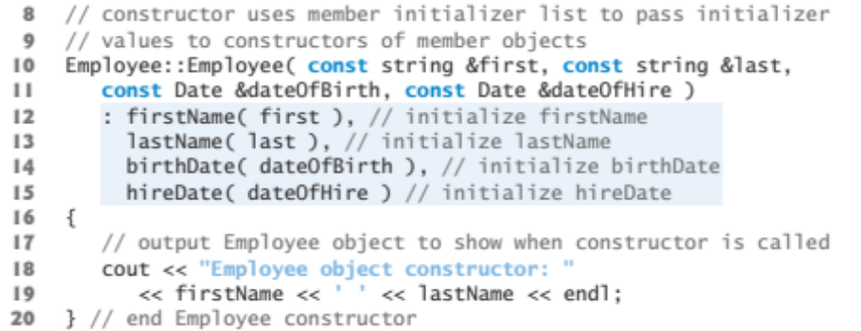
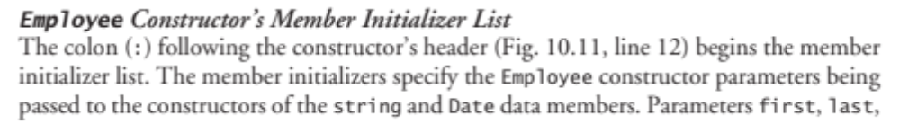
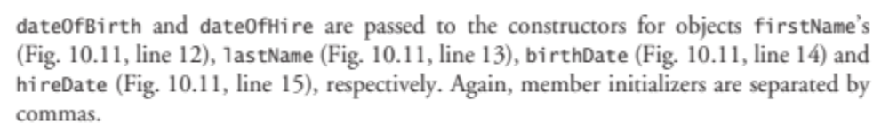
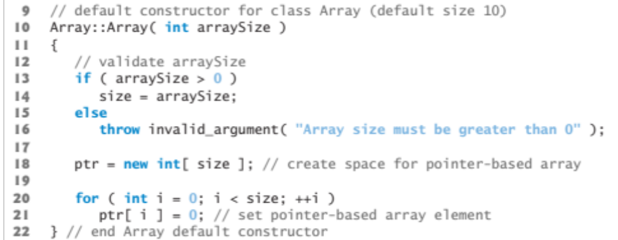
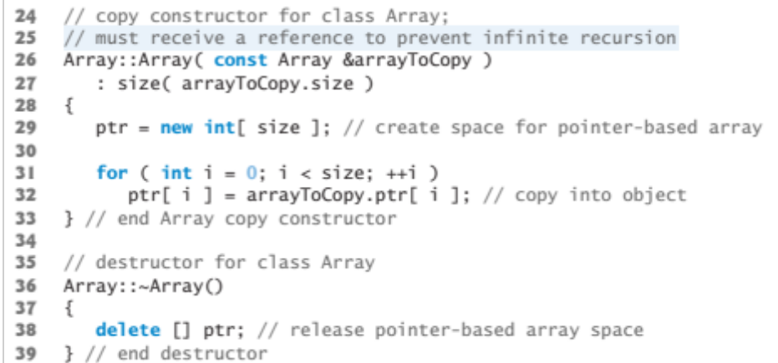
Member initializer list, separated by commas
Default and copy constructors
A copy constructor is a special constructor in the C++ programming language for creating a new object as a copy of an existing object. The first argument of such a constructor is a reference to an object of the same type as is being constructed (const or non-const), which might be followed by parameters of any type (all having default values).
Normally the compiler automatically creates a copy constructor for each class (known as a default copy constructor) but for special cases the programmer creates the copy constructor, known as a user-defined copy constructor. In such cases, the compiler does not create one. Hence, there is always one copy constructor that is either defined by the user or by the system.

Slide 34
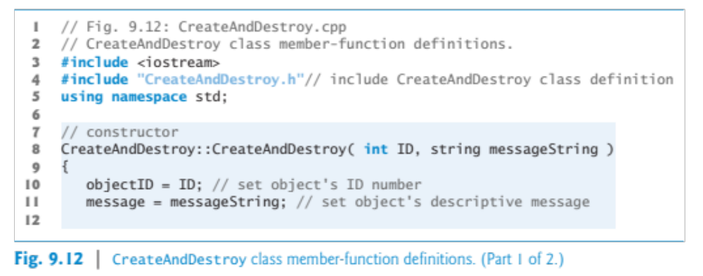
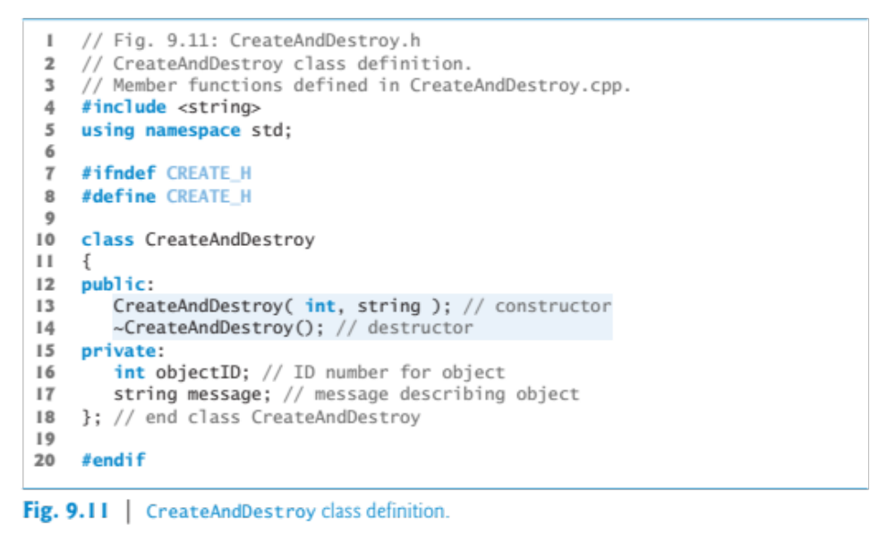
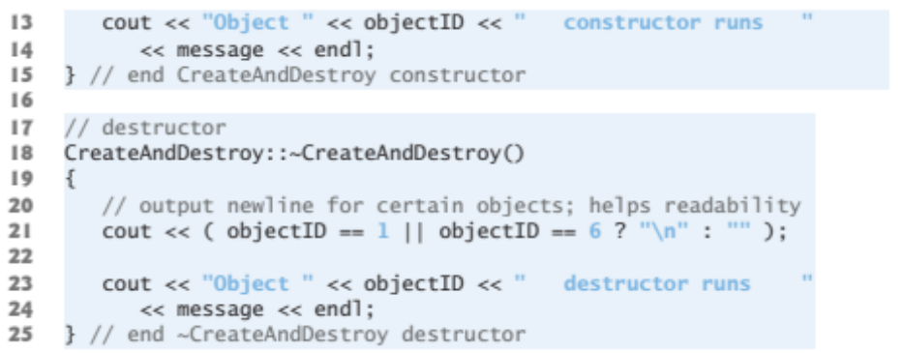
Let’s do an example with a constructor and destructor, these are quite common

Slide 35
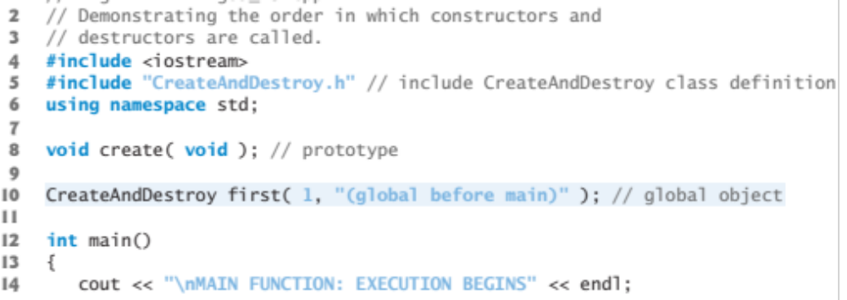
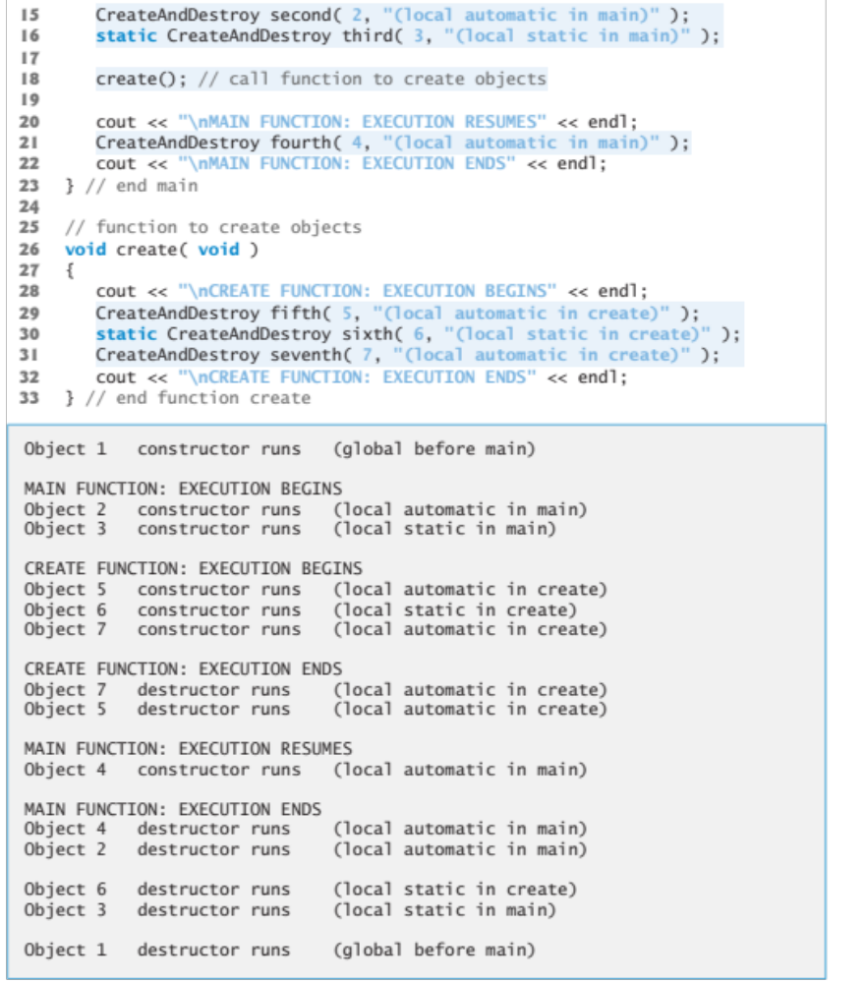

Slide 36
This is the copy-paste-able source code
// CreateAndDestroy class definition.
// Member functions defined in CreateAndDestroy.cpp.
#include <string>
using namespace std;
#ifndef CREATE_H
#define CREATE_H
class CreateAndDestroy
{
public:
CreateAndDestroy( int, string ); // constructor
~CreateAndDestroy(); // destructor
private:
int objectID; // ID number for object
string message; // message describing object
}; // end class CreateAndDestroy
#endif
// Demonstrating the order in which constructors and
// destructors are called.
#include <iostream>
#include "CreateAndDestroy.h" // include CreateAndDestroy class definition
using namespace std;
void create( void ); // prototype
CreateAndDestroy first( 1, "(global before main)" ); // global object
int main()
{
cout << "\nMAIN FUNCTION: EXECUTION BEGINS" << endl;
CreateAndDestroy second( 2, "(local automatic in main)" );
static CreateAndDestroy third( 3, "(local static in main)" );
create(); // call function to create objects
cout << "\nMAIN FUNCTION: EXECUTION RESUMES" << endl;
CreateAndDestroy fourth( 4, "(local automatic in main)" );
cout << "\nMAIN FUNCTION: EXECUTION ENDS" << endl;
} // end main
// function to create objects
void create( void )
{
cout << "\nCREATE FUNCTION: EXECUTION BEGINS" << endl;
CreateAndDestroy fifth( 5, "(local automatic in create)" );
static CreateAndDestroy sixth( 6, "(local static in create)" );
CreateAndDestroy seventh( 7, "(local automatic in create)" );
cout << "\nCREATE FUNCTION: EXECUTION ENDS" << endl;
} // end function create
// CreateAndDestroy class member-function definitions.
#include <iostream>
#include "CreateAndDestroy.h" // include CreateAndDestroy class definition
using namespace std;
// constructor
CreateAndDestroy::CreateAndDestroy( int ID, string messageString )
{
objectID = ID; // set object's ID number
message = messageString; // set object's descriptive message
cout << "Object " << objectID << " constructor runs "
<< message << endl;
} // end CreateAndDestroy constructor
// destructor
CreateAndDestroy::~CreateAndDestroy()
{
// output newline for certain objects; helps readability
cout << ( objectID == 1 || objectID == 6 ? "\n" : "" );
cout << "Object " << objectID << " destructor runs "
<< message << endl;
} // end ~CreateAndDestroy destructor

Slide 37
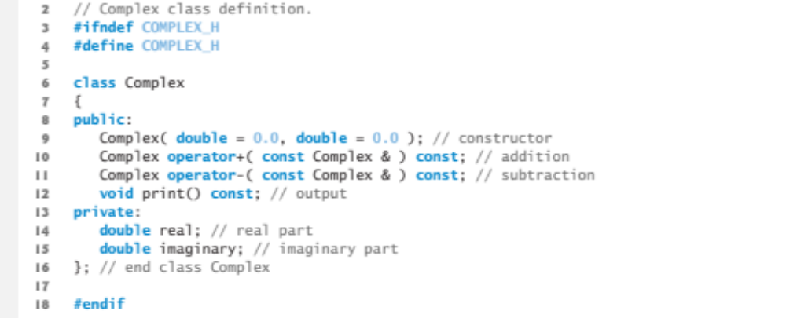
Definition for a complex number class with real and imaginary parts

Slide 38
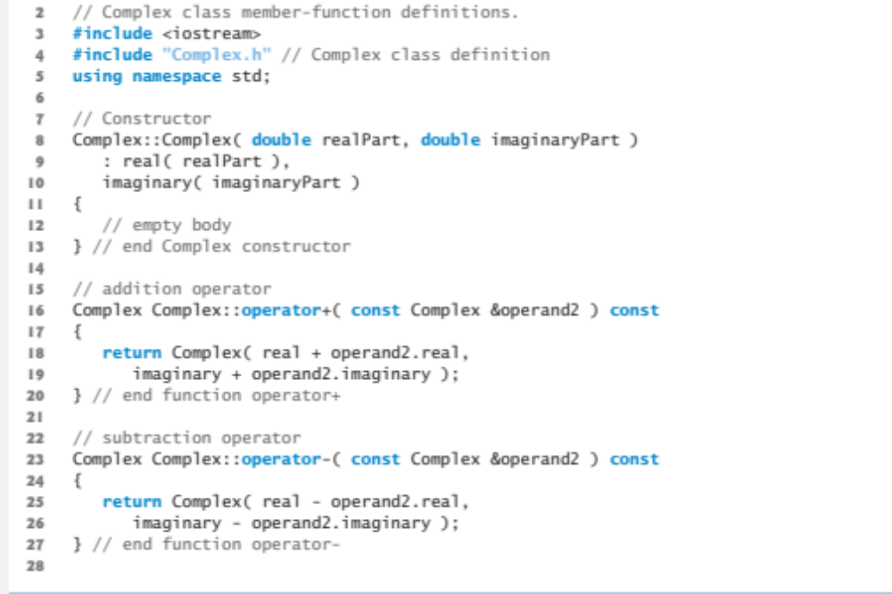

Slide 39
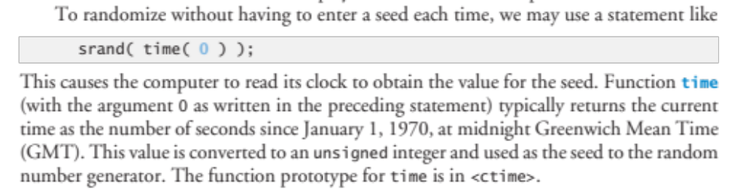
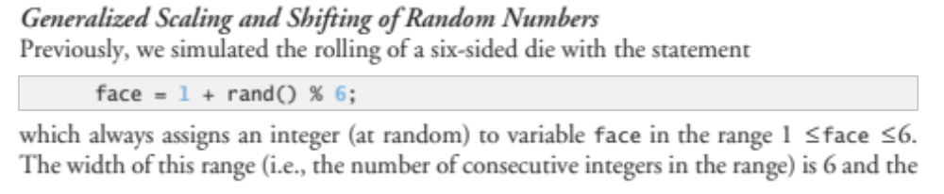
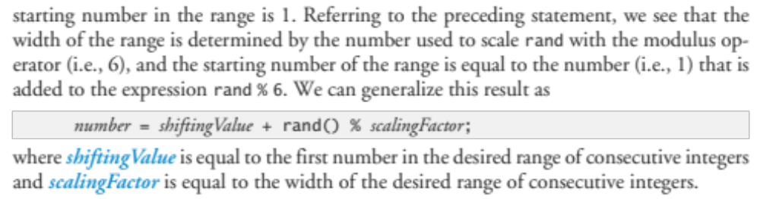

Slide 40
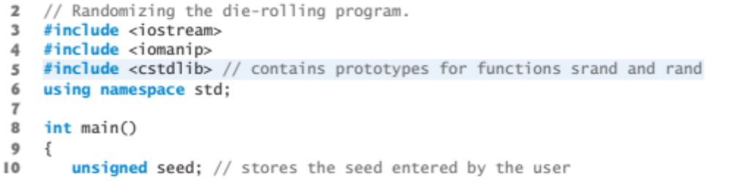
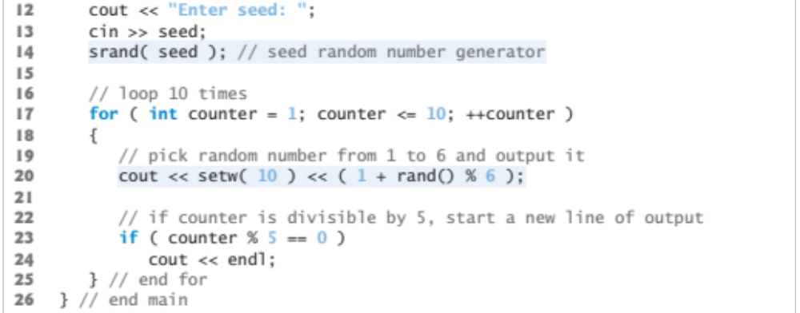
A simple die-rolling program

Slide 41
Source code for die-rolling program
// Randomizing die-rolling program.
#include <iostream>
#include <iomanip>
#include <cstdlib> // contains prototypes for functions srand and rand
using namespace std;
int main()
{
unsigned seed; // stores the seed entered by the user
cout << "Enter seed: ";
cin >> seed;
srand( seed ); // seed random number generator
// loop 10 times
for ( int counter = 1; counter <= 10; ++counter )
{
// pick random number from 1 to 6 and output it
cout << setw( 10 ) << ( 1 + rand() % 6 );
// setw is "set width" of output operations
// if counter is divisible by 5, start a new line of output
if ( counter % 5 == 0 )
cout << endl;
} // end for
} // end main

Slide 42
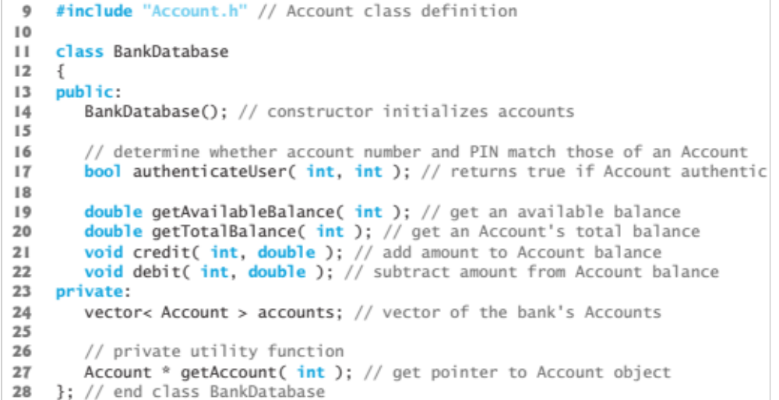
Here is a BankDatabase class

Slide 43
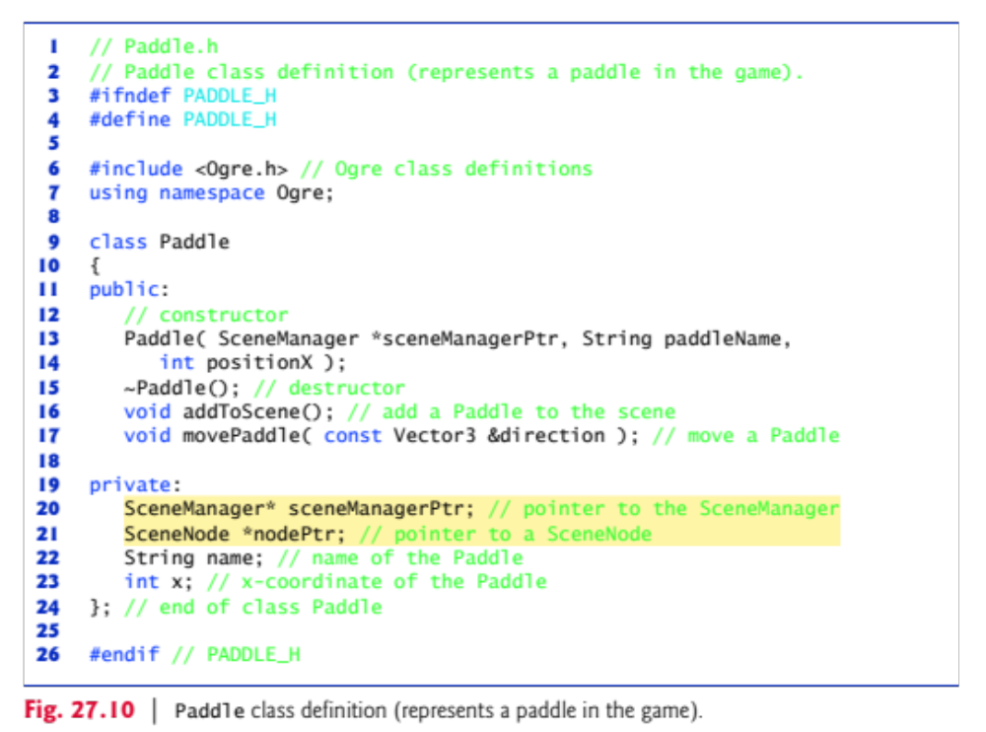
Here is a Paddle class

Slide 44
Homework for Next Monday (pick two)
1) Write a class for a character in gameplay, with set() and get() methods. You should be able to get() or set() the player’s health, location, direction of movement, velocity, and any gear he/she has with him. What character data should be public or protected or private? What data structure should be used for the player’s direction or current location? What data structure should be used for his/her gear? Write how a driver class can interact with the character class, by updating, interacting with other characters, or interacting with the environment.
2) Design and implement a blackjack or twenty-one game using the randomization functions we have used for cards/suits. Allow playing against the computer as the “house.” Reveal all the cards at the end of a hand.
3) Write a function mysort() that takes an array of integers or floating point values and returns them sorted from least to greatest. Bonus 1: Pass the array by reference and change the original array. Bonus 2: Include an option to sort the array from greatest to least.
4) Make a dice rolling program that rolls two dice of any number of sides. Bonus: Implement a standard dice game of your choice (http://en.wikipedia.org/wiki/List_of_dice_games).
5) Outline how to implement the game Pong using pseudocode and/or class diagrams (http://en.wikipedia.org/wiki/Class_diagram). Bonus: Implement one of these classes.

Slide 45
Homework for Next Monday (pick two)
6) Write a concatenate function that takes a variable number of arguments (may or may not be of different data types) and returns their concatenation as a string.
7) Overload the ‘+’ operator to concatenate not only strings but also integers and/or floating point numbers.
8) Write a .cpp file that uses a function prototype and default parameters for a function.

